Slide 1
COMPUTER SCIENCE
Leaving Cert

Slide 2
Computer Science
Computer Science was introduced as a new Leaving Certificate subject in 2018.
Adamstown CC was chosen as one of forty schools in Ireland to pilot the subject.

Slide 3
What is Computer Science?
The study of algorithms and programming, and the impact of computers on society.
Develops creative ways to solve problems and evaluate solutions.
It is about finding automated solutions to almost any problem you can imagine.

Slide 4
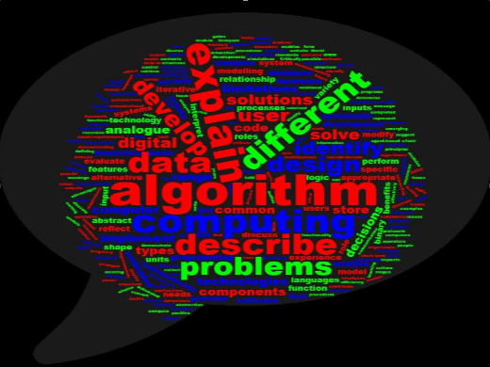
The Computer Science specification defines the Learning Outcomes which students must achieve to complete the course.
These are contained in 3 strands.

Slide 5


Slide 6
Strand 1: Practices and Principles
Computational Thinking
Computers and Society
Computing Developments - Turing Machines, AI, The Internet
Designing and Developing

Slide 7
Strand 2: Core Concepts
Abstraction
Algorithms
Computer Systems
Data
Evaluation and Testing

Slide 8
Strand 3: Computer Science in Practice
Over the two years of the course, students will engage with four applied learning tasks.
These will be group tasks in which groups plan, design and develop computational artefacts.

Slide 9
ALT2 - Data Analytics
This task involves finding a dataset (like a spreadsheet) and using Python to analyse it and create a graph.

Slide 10
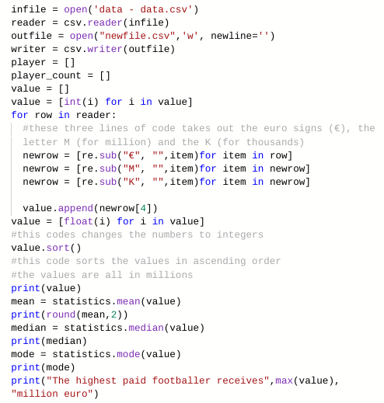
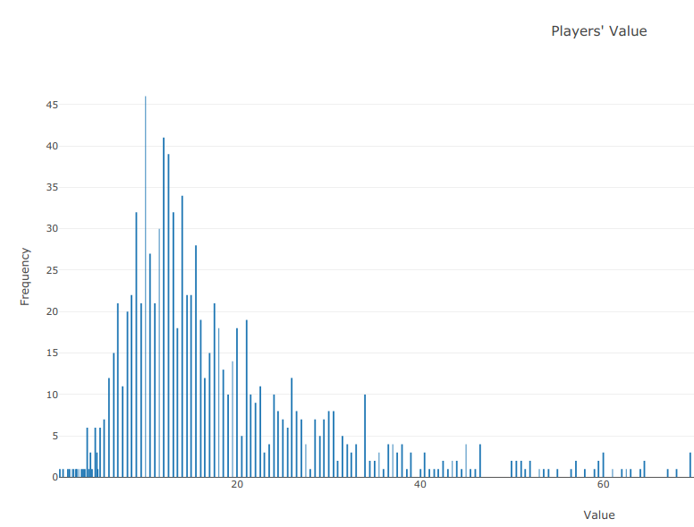
ALT 2: Analytics

Slide 11
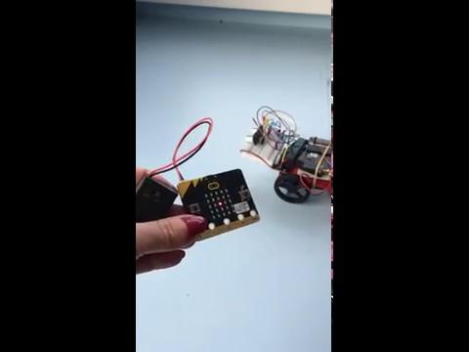
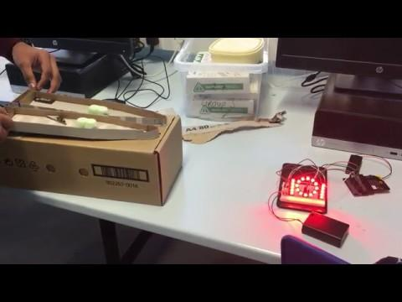
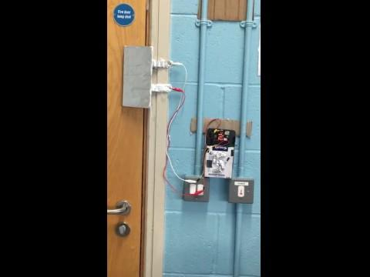
ALT 4
Embedded Systems

Slide 12
ALT 4 - Embedded Systems
This task involves planning, designing and coding an artefact using a microbit.
A recent theme was security.

Slide 13
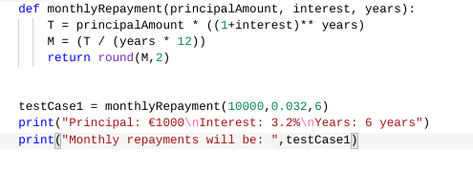

ALT 3: Modelling and Simulation
Develop a model that will allow different scenarios to be tested.
Analyse and interpret the outcome of simulations before and after modifications have been made.

Slide 14
ALT 1: Interactive Information Systems
This task uses HTML, CSS and Javascript to create a website.
A database is created to store all the information which is then displayed on the website.

Slide 15
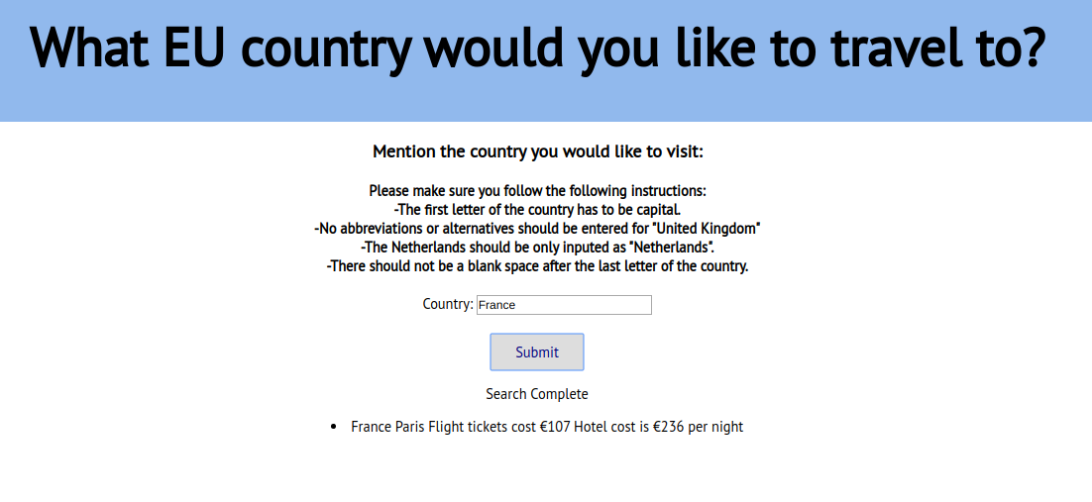

Slide 16
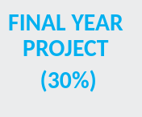
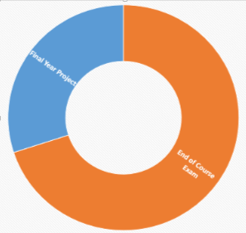
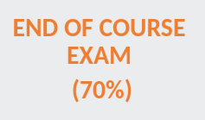
Assessment

Slide 17
The languages that will be tested are Python and HTML/CSS and Javascript
We will use BBC Microbits as part of embedded systems
There will be an individual 12 week coursework assignment beginning in December of 6th year.
The Leaving Cert exam will be in May of 6th year.
It will consist of a 1 hour Coding practical on a computer and a 1 ½ hours written exam.

Slide 18
Required Materials
Google Classroom Code: io6xz7y2
Folder
A4 copy
Book - Computer Science for Leaving Certificate
Device to work on at home

Slide 19
Getting Started….
Team Work
Computational Thinking

Slide 20
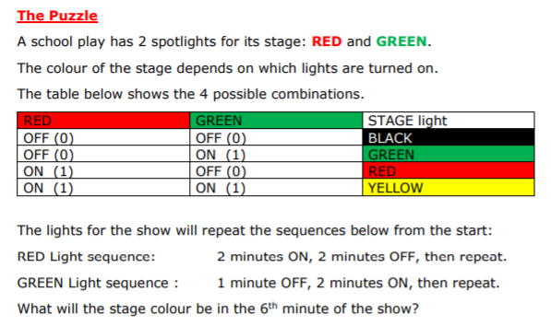

Slide 21
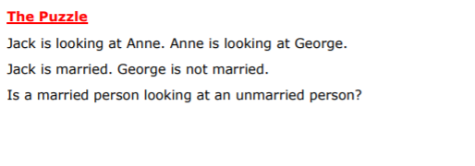

Slide 22
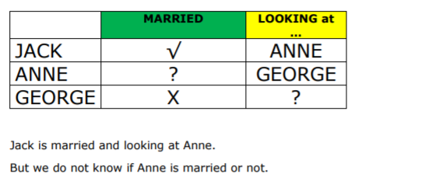

Slide 23
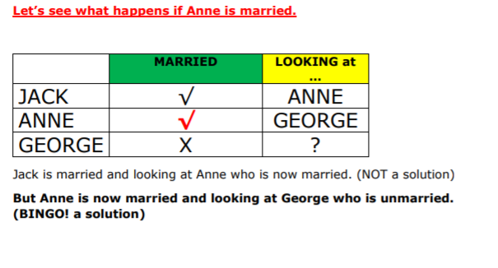

Slide 24
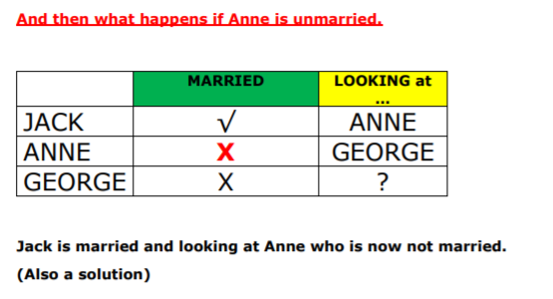

Slide 25
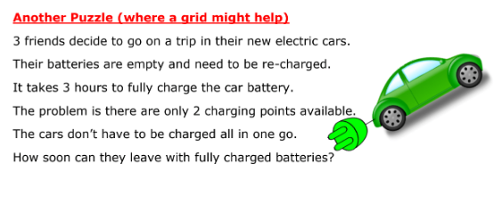

Slide 26
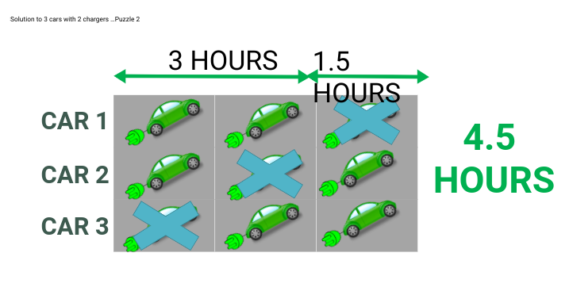

Slide 27
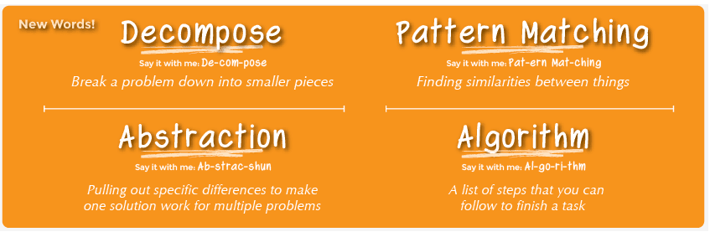
The purpose of these puzzles is not necessarily to solve them fully!
The purpose is to practise the core elements of Computational Thinking.

Slide 28
For example :
Abstraction : See if you can figure out the vital information within the problem. Perhaps use variables to represent information. (Puzzle 1 and 3)
Decomposition : Break down the problem into smaller parts. Build information from the bottom up. (Puzzle 2 and 4)

Slide 29
Computational Thinking
Core Concepts

Slide 30
What is Computational Thinking?
Computational thinking is a way of understanding complex problems in order to form a solution that can be implemented by either a computer, a human or a combination of both.
There are four key elements to computational thinking:
Decomposition - breaking a problem down into smaller pieces
Abstraction - removing details that are not relevant to solving a problem
Algorithmic thinking - identifying logical steps/a set of instructions that can be used to solve a problem
Pattern Recognition - Finding patterns or similarities

Slide 32
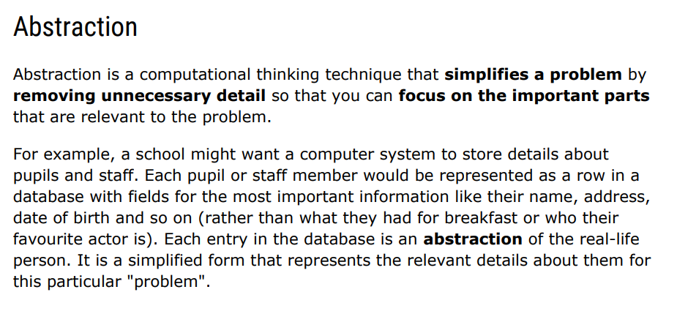

Slide 33
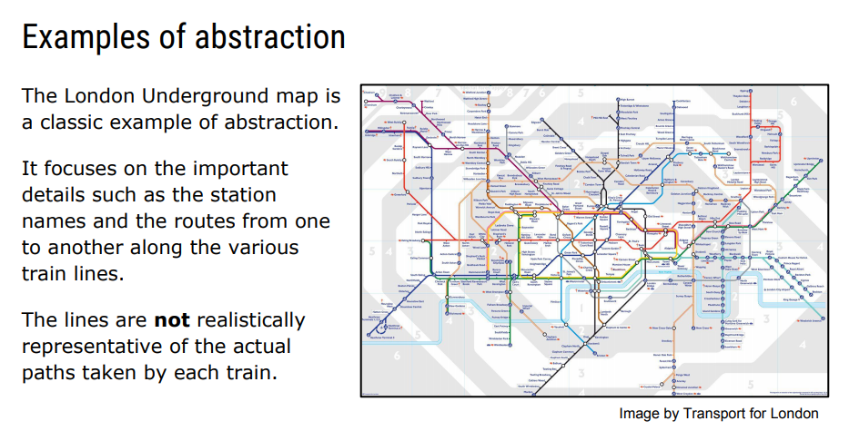

Slide 34
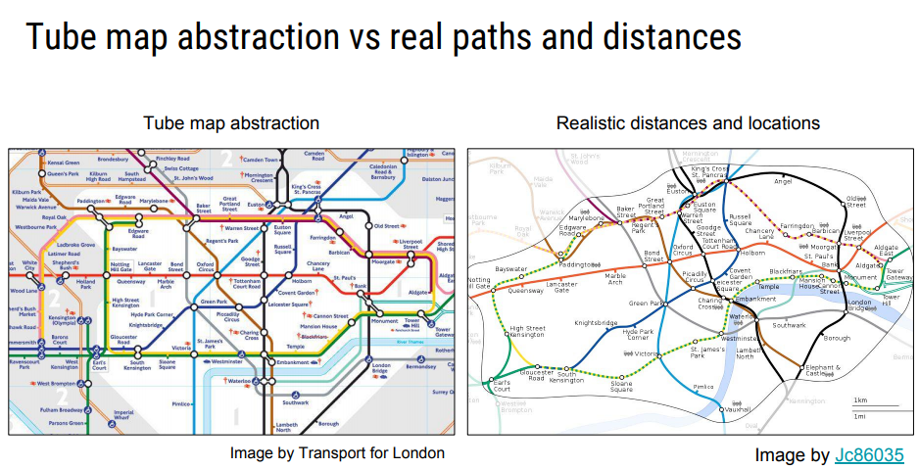

Slide 35
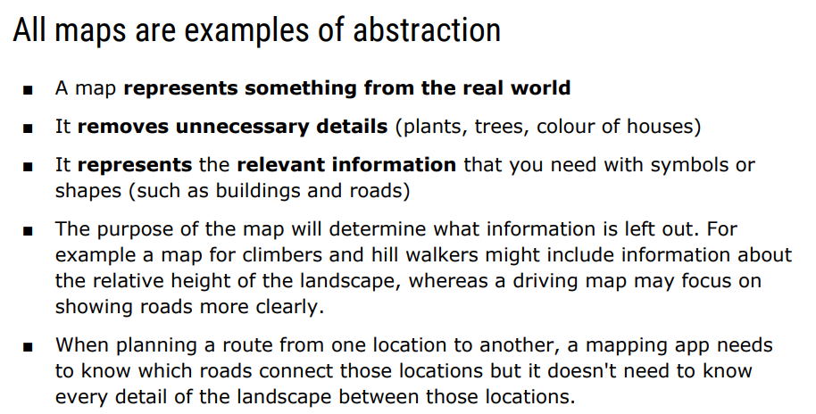

Slide 36
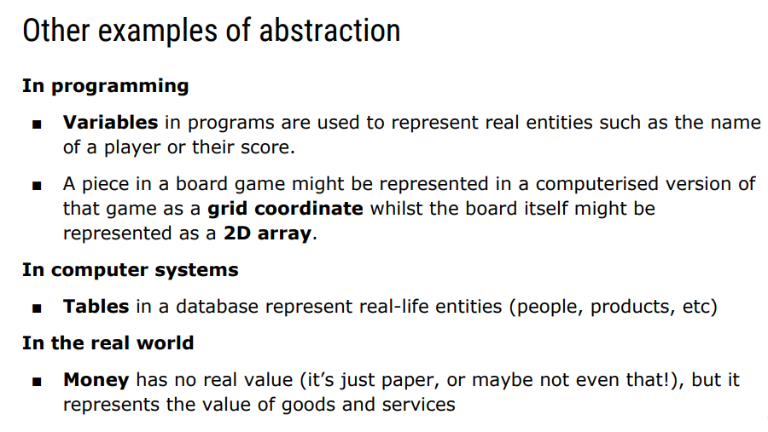

Slide 37
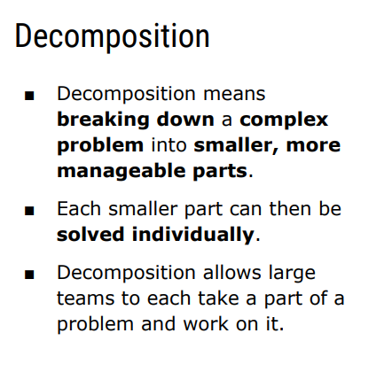

Slide 38
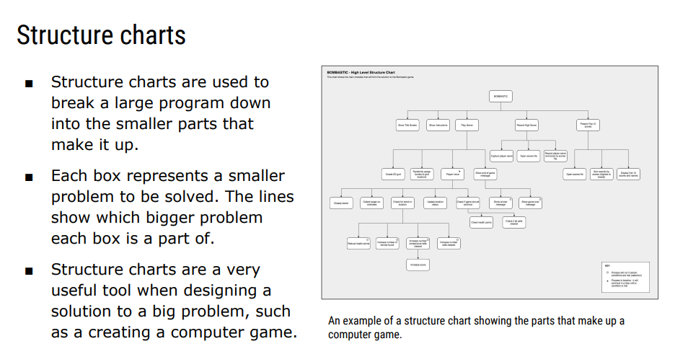

Slide 39
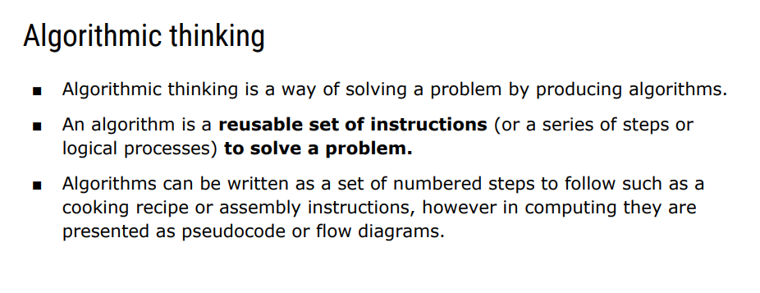

Slide 40
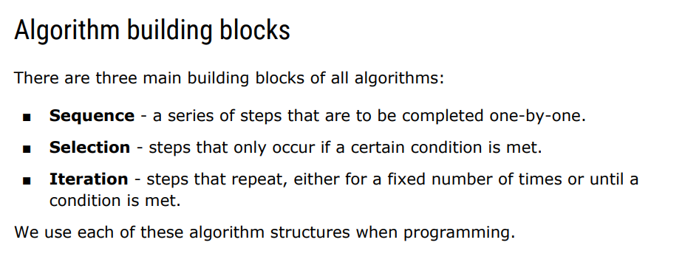

Slide 41
Drawing a grid or a graph or changing the form of the puzzle in some way, can often help solve problems in a systematic fashion.
If you get stuck on these puzzles, try drawing a GRID (or a two-way table) might help you get unstuck!!

Slide 42
Couples
Tomás, Davey, Hugh, and Fran are married to Ger, Jane, Sinéad and Bernie, though not necessarily in that order.
Jane, who is Davey’s sister, has five children. Tomás and his partner want to wait a few more years before starting a family.
Tomás has never introduced his wife to Sinéad.
Sinéad works very closely with Davey. Ger is considering telling Davey’s partner that they are working a bit too closely together these days.
Davey and Hugh, by the way, are twin brothers. Who is married to wham?

Slide 43
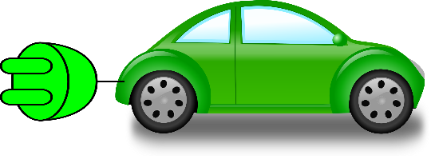
A Solution to who is married to whom?
Ger
Jane
Sinéad
Bernie
Tomas/Sinead info.
Tomás
Davey
Jane/Davey siblings.
Hugh
Jane -5 kids /
Tomas – 0 kids
Fran
?
Sinead/Davey work
Ger not with Davey
Notes:
These first steps, decomposing the information, lead by elimination to Bernie and Davey as partners.
The next step is Davey Hugh Jane are siblings, thus placing an X on the Hugh Jane box. Thus, Jane and Fran are partners.

Slide 44
Windows
Somebody has broken the window in the classroom. There are three suspects: Anne, Barbara and Clara.
Anne said that Barbara broke the window. Barbara and Clara also said something but nobody remembers what they said. It is known that exactly one of the girls broke the window and only this girl told the truth. Who broke the window?

Slide 45
Windows: Solution
If A broke the window then A told the truth. But A said B broke the window, not A. So A was lying. So A didn’t break the window. And B breaking the window was a lie. Hence C broke the window.

Slide 46
Computational Thinking
"Computational Thinking is a loose set of problem solving skills that mainly focus on the creation of algorithms."
(Curzon P, McOwan P. (2017) The Power of Computational Thinking)
Other puzzles also known as Zebra Puzzles or Einstein Puzzle – Relies on Logic to solve
https://www.zebrapuzzles.com/p/MqQOKqY2/#very-easy

Slide 47
Computational Thinking
The purpose of these puzzles is not necessarily to solve them fully!
The purpose is to practise the core elements of Computational Thinking.
Pattern Recognition: See if there is a pattern
Abstraction : See if you can figure out the vital information within the problem. Perhaps use variables to represent information.
Decomposition : Break down the problem into smaller parts. Build information from the bottom up.
Algorithm Design: Can you make a set of instructions to solve the problem

Slide 48
M&M’s
A shopkeeper receives three boxes of sweets from a supplier. One box contains peanut M&M’s, the second is filled with chocolate M&M’s and the third box is a mix of the two types. Unfortunately all the boxes are labelled incorrectly. If he can’t see into the box but can put his hand into take a sweet, what is the minimum number of sweets he needs to take out to figure out which box is which?
Explain!

Slide 49
M&M’s
If none of the labels are correct then by taking a single sweet from the box labelled ‘Mixed Box’ you should be able to solve it.
If the sweet you pick is a peanut M&M then that has to be all the peanut M&M’s.
That leaves chocolate and mixed M&M’s in either box labelled chocolate or peanut.
Because all the labels are wrong that means the chocolate M&M’s can’t be in the box labelled ‘Chocolate’ so must be in the box labelled ‘Peanut’, leaving mixed M&M’s in the box labelled ‘Chocolate’

Slide 50
Fishing Holes
Inuit children are sent out to find out about fishing holes and polar bears. They are only interested in polar bears that are at fishing holes, as their presence would frighten Inuit fisherman.
They communicate information using 2 dice, which serve also as fasteners for their coats.
Here’s some results:
Dice 1 Dice 2 Meaning
4 3 1 fishing hole and 2 polar bears
2 5 1 fishing hole and 4 polar bears
2 2 no f.h. so no polar bears of interest
3 5 2 fishing holes and 6 polar bears
5 5 2 fishing holes and 8 polar bears
Question
What’s the key to translating the dice data to useful information?

Slide 51
If the dice is odd (or has a centre dot) then it counts as a fishing hole so if we have the dice 3,2 that's 1 fishing hole but 3,3 or 1,3 is 2 fishing holes etc. Then the number of polar bears is the number of dots that surround any centre dots... So a 5 face would count as 4 polar bears, a 3 face as 2 bears and a 4 face is zero bears because there is no centre dot.

